Slide 1

Highlights of New Wild Poliovirus and cVDPV Positives
Reported Globally this Week
¹contacts of positive AFP cases, community, healthy children
The boundaries and names shown and the designations used in the maps in this document do not imply the expression of any opinion whatsoever on the part of the World Health Organization concerning the legal status of any country, territory, city or area or of its authorities, or concerning the delimitation of its frontiers or boundaries. Dotted lines on maps represent approximate border lines for which there may not yet be full agreement. © WHO 2020. All rights reserved
Data in WHO HQ as of 17 Nov. 2020

Slide 2
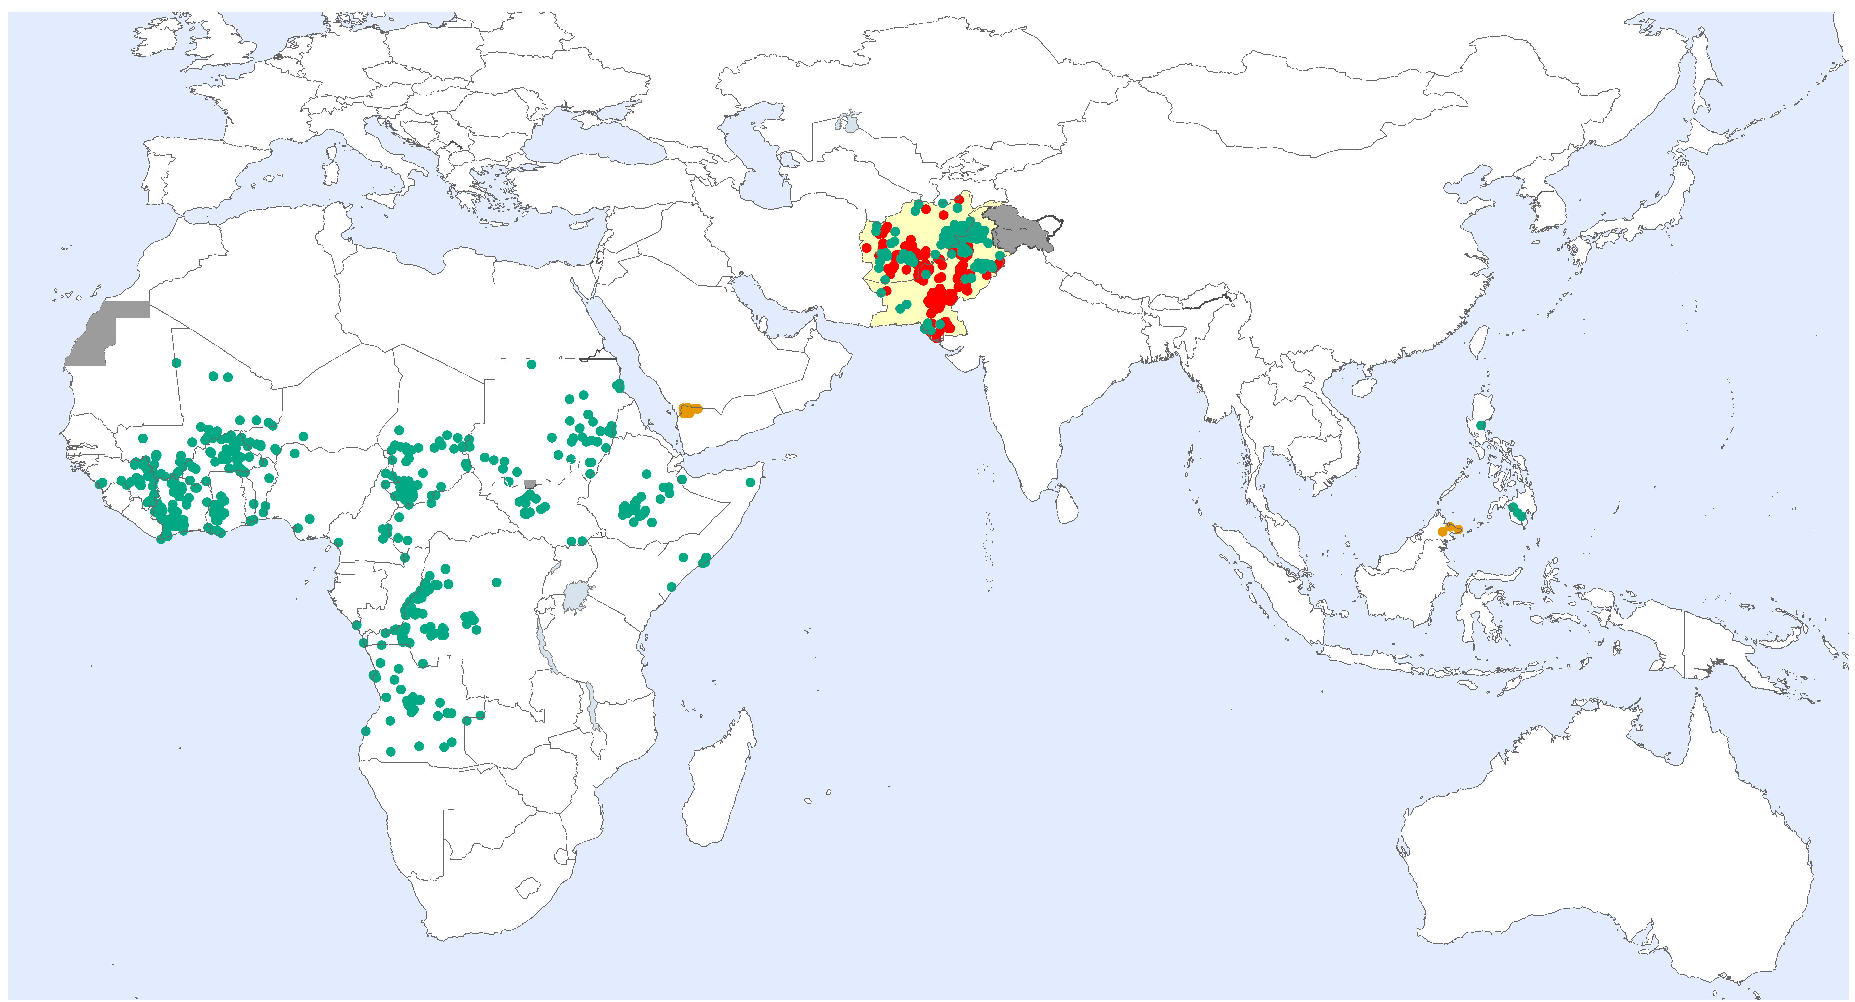
Global WPV1 & cVDPV Cases¹, Previous 12 Months²
Endemic country (WPV1)
¹Excludes viruses detected from environmental surveillance; ²Onset of paralysis 18 Nov. 2019 – 17 Nov. 2020
Notes:
Table in 05A.SummaryTablesPOLIS_SJ

Slide 3
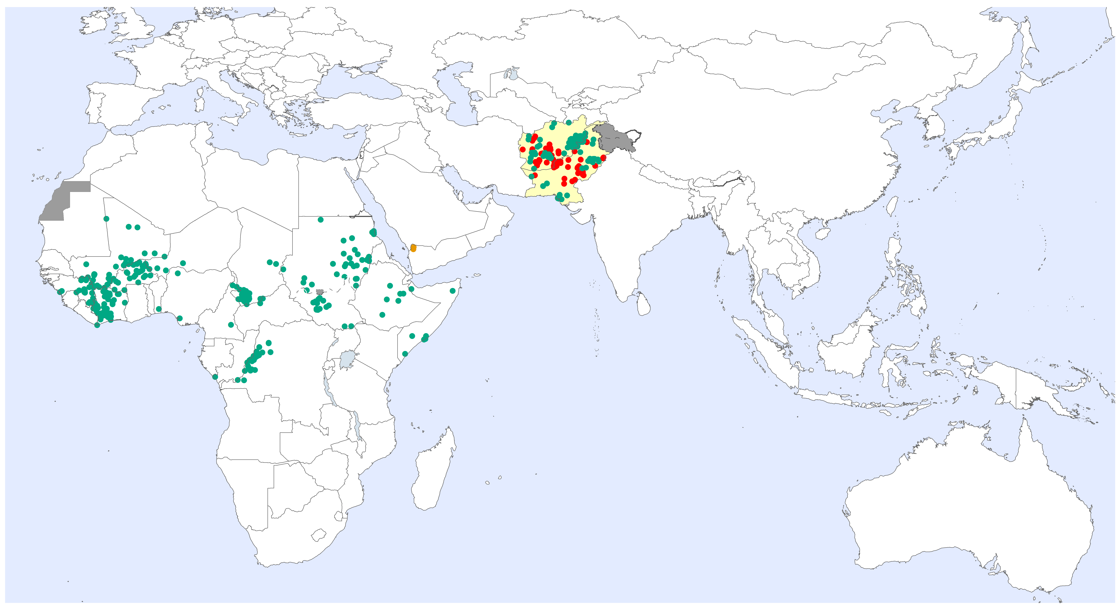
Global WPV1 & cVDPV Cases¹, Previous 6 Months²
Endemic country (WPV1)
¹Excludes viruses detected from environmental surveillance ; ²Onset of paralysis: 18 May – 17 Nov . 2020

Slide 4
Global Wild Poliovirus 2015 - 2020
Notes:
Table in 01.Global_Update_WildVirusSummary
POLISdata2018 sheet to be updated first

Slide 5
Global Circulating Vaccine-derived Poliovirus (cVDPV)^{1,2,3}
¹For cVDPV definition see http://polioeradication.org/wp-content/uploads/2016/09/Reporting-and-Classification-of-VDPVs_Aug2016_EN.pdf . Niger 2006, Niger 2009, Niger 2010, Chad 2010 cVDPVs are linked to the Nigeria outbreak. Kenya 2012 cVDPVs are linked to the Somalia outbreak. Nigeria figures include cases with WPV1/cVDPV2 mixture: 2005 - 2, 2006 - 1, 2007 - 1, 2008 - 3, 2009 - 1, 2011 - 1; WPV3/cVPDV2 mixture: 2007 - 2. ² include a cVDPV2 from a contact of a WPV1 case in Nigeria. ³Figures include multiple emergences. ⁴ stool collected in Sep - 2016 but the final result was reported in 2017. ⁵ Include contact, healthy and community samples . Positive contact of a negative index AFP case double counted in both AFP cases and other sources count . ⁶ 1 cVDPV2 and cVDPV3 isolated from one child
Notes:
Table in 01.Global_Update_WildVirusSummary

Slide 6

Global Surveillance Indicators: Year to Date Comparison
2019 & 2020: 01 January to 17 November 2020*
¹cVDPV includes all three serotypes 1, 2 and 3. Please refer to slide 5 for the distribution of cases by serotypes.
For data at country, regional and global levels from 2000 onwards, see the WHO website at https://extranet.who.int/polis/public/CaseCount.aspx
*Data for 2019 as of 18 Nov. 2019 and for 2020 as of 17 Nov. 2020

